Slide 1

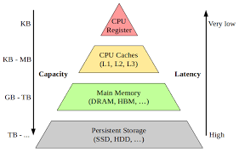
Shift Registers
Chapter 8
Week 1
Sumaiyah Zahid

Slide 2
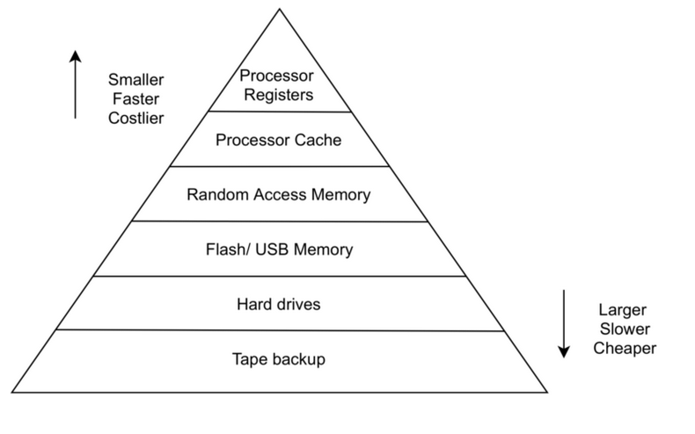
Registers
The smallest and fastest memory
It is used solely for storing and shifting data (1s and 0s)
A register can consist of one or more flip-flops used to store and shift data.

Slide 3
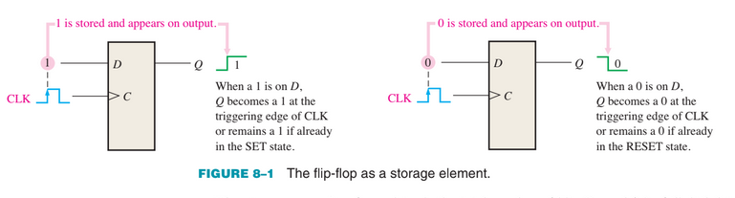
Registers
The storage capacity of a register is the total number of bits (1s and 0s) of digital data it can retain.
Each stage (flip-flop) in a shift register represents one bit of storage capacity; therefore, the number of stages in a register determines its storage capacity.

Slide 4
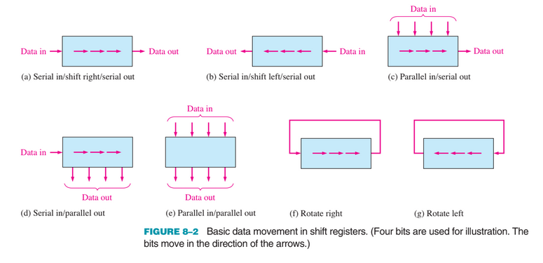
Shift Registers

Slide 5
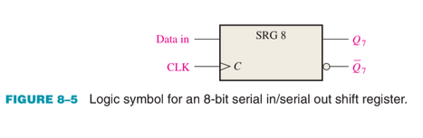
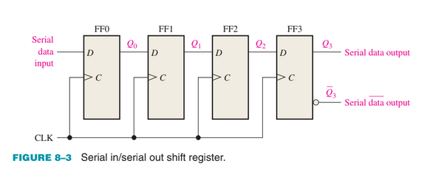
Serial In/Serial Out Shift Registers
4-bit Register implemented with 4 D flip-flops.
With four stages, this register can store up to four bits of data.

Slide 6
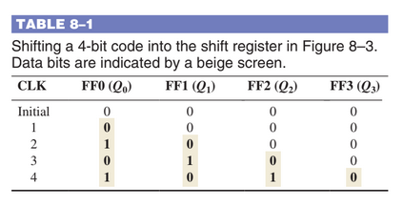
Serial In/Serial Out Shift Registers
For serial data, one bit at a time is transferred.

Slide 7
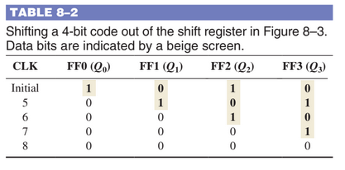
Serial In/Serial Out Shift Registers
For serial data, one bit at a time is transferred.

Slide 8
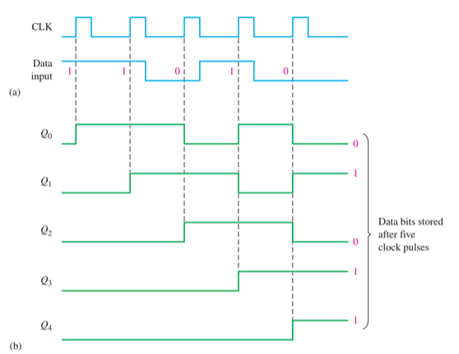
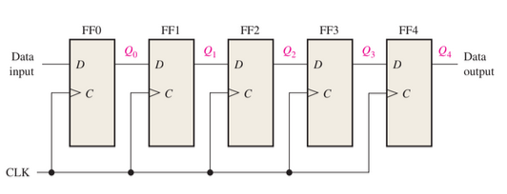
Serial In/Serial Out Shift Registers

Slide 9
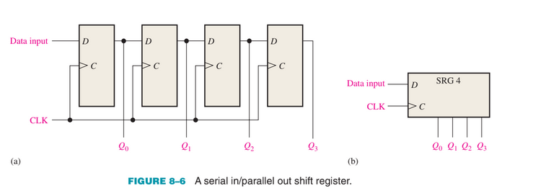
Serial In/Parallel Out Shift Registers
Data bits are entered serially least-significant bit first

Slide 10
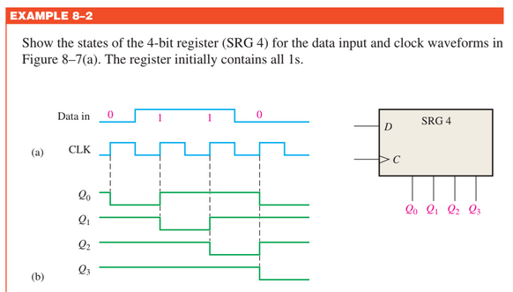
Serial In/Parallel Out Shift Registers

Slide 11
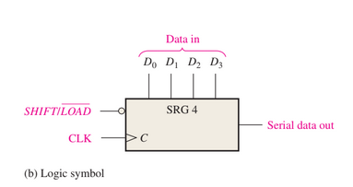
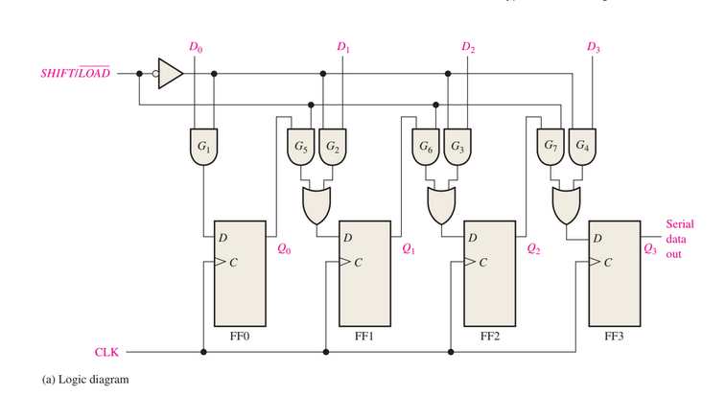
Parallel In/Serial Out Shift Registers
For parallel data, multiple bits are transferred at one time.

Slide 12
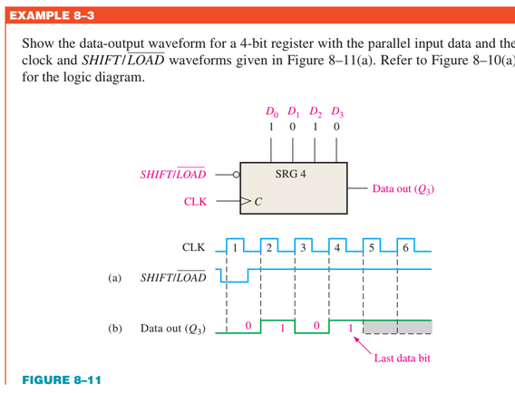
Parallel In/Serial Out Shift Registers

Slide 13
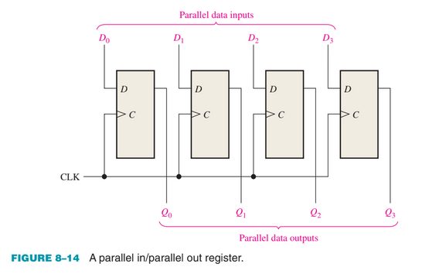
Parallel In/Parallel Out Shift Registers

Slide 14
Home TAsks
1. Develop the logic diagram for the shift registers using J-K flip-flops to replace the D flip-flops.
2. How many clock pulses are required to enter a byte of data serially into an 8-bit shift register?
3. The bit sequence 1101 is serially entered (least-significant bit first) into a 4-bit parallel out shift register that is initially clear. What are the Q outputs after two clock pulses?
4. How can a serial in/parallel out register be used as a serial in/serial out register?
5. Explain the function of the SHIFT/LOAD input.
6. Is the parallel load operation in Parallel in Serial Out shift register synchronous or asynchro nous? What does this mean?

Slide 15
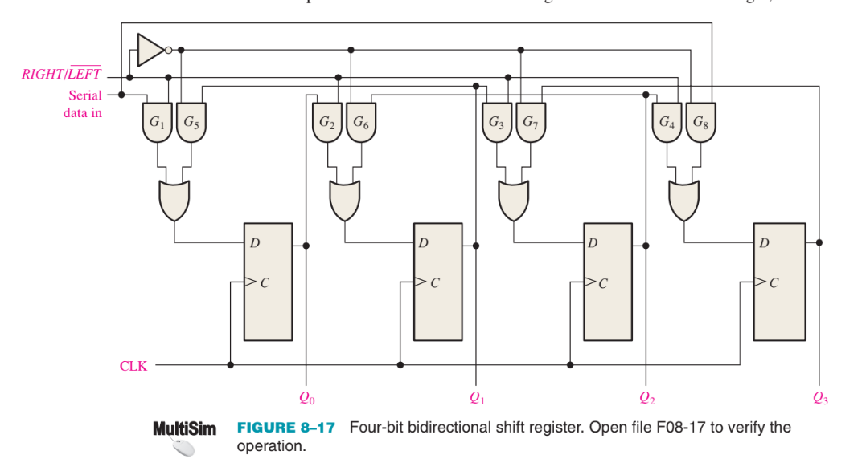
Bidirectional Shift Registers

Slide 16
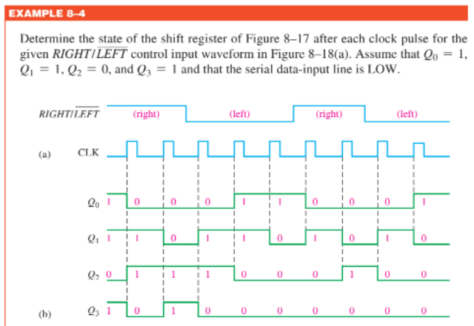
Bidirectional Shift Registers

Slide 17
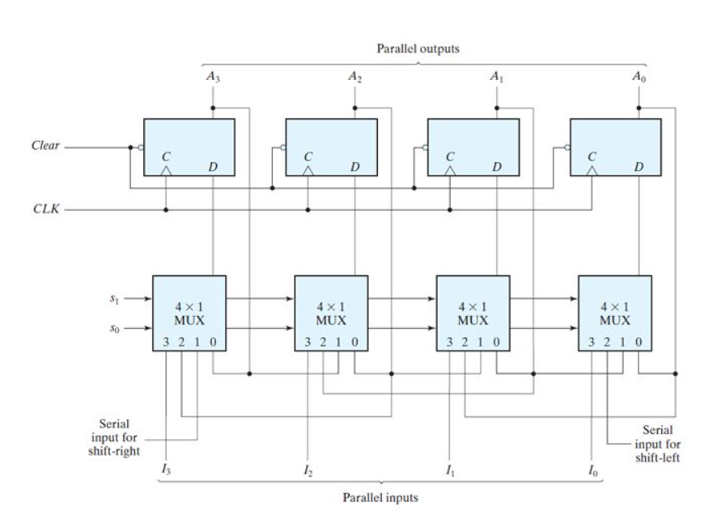
Universal Shift Register

Slide 18
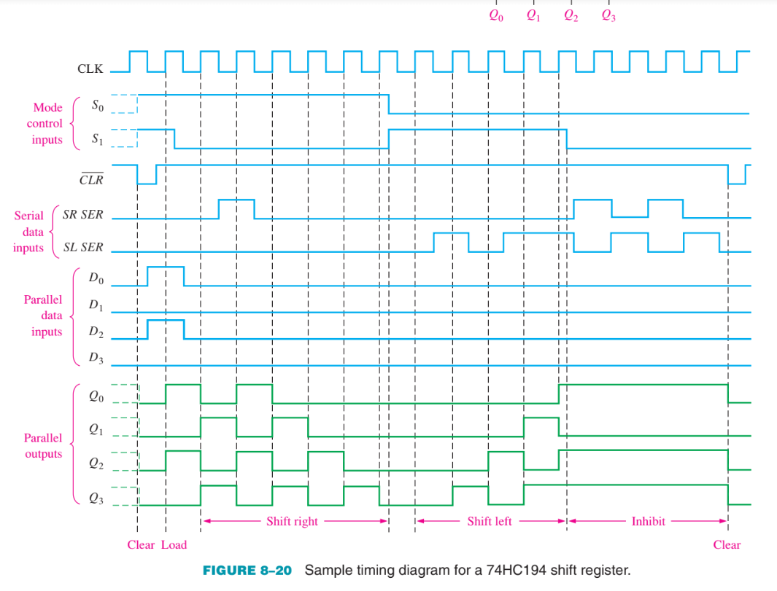
Universal Shift Register

Slide 19
Shift Register Counter
The Johnson Counter
4-bit sequence has a total of eight states, or bit patterns. 5-bit sequence has a total of ten states
In general, a Johnson counter will produce a modulus of 2n, where n is the number of stages in the counter.
Extensively used as frequency dividers and pattern recognizers.

Slide 20
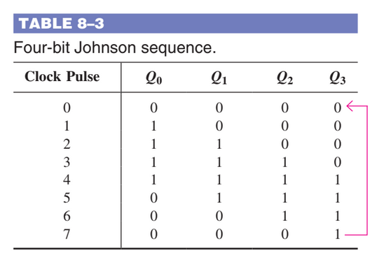
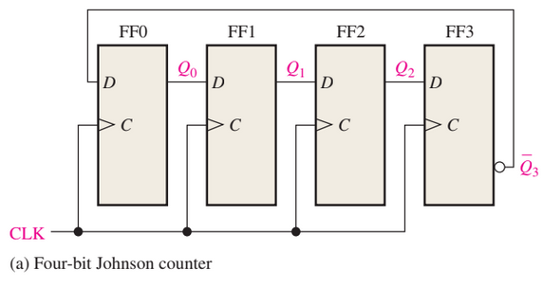
Shift Register Counter ~ The Johnson Counter

Slide 21
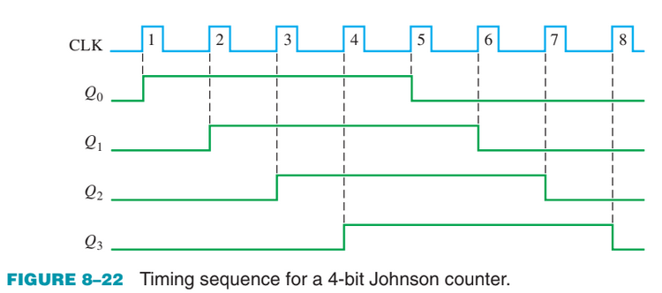
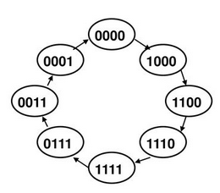
Shift Register Counter ~ The Johnson Counter
Johnson counters are used as frequency dividers and pattern recognizers.
It can be used to create complicated finite state machines in hardware logic design.

Slide 22
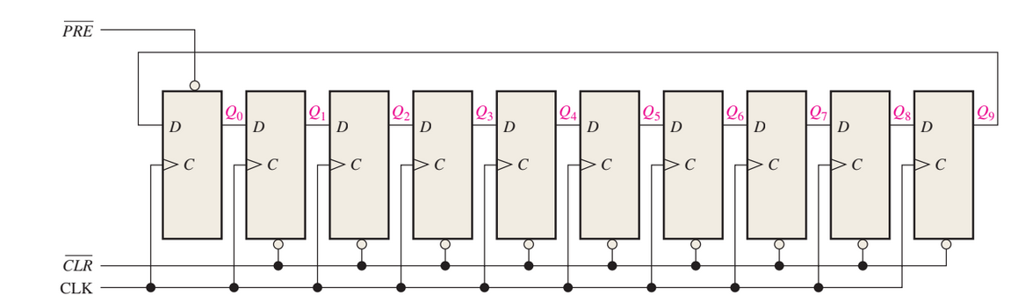
Shift Register Counter
The Ring Counter
A ring counter utilizes one flip-flop for each state in its sequence. For 10-bit ring counter, there is a unique output for each decimal digit.

Slide 23
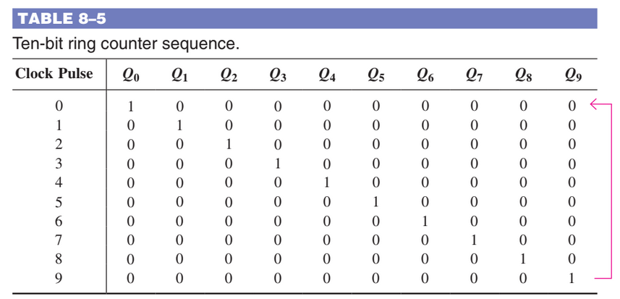
Shift Register Counter ~ The Ring Counter

Slide 24
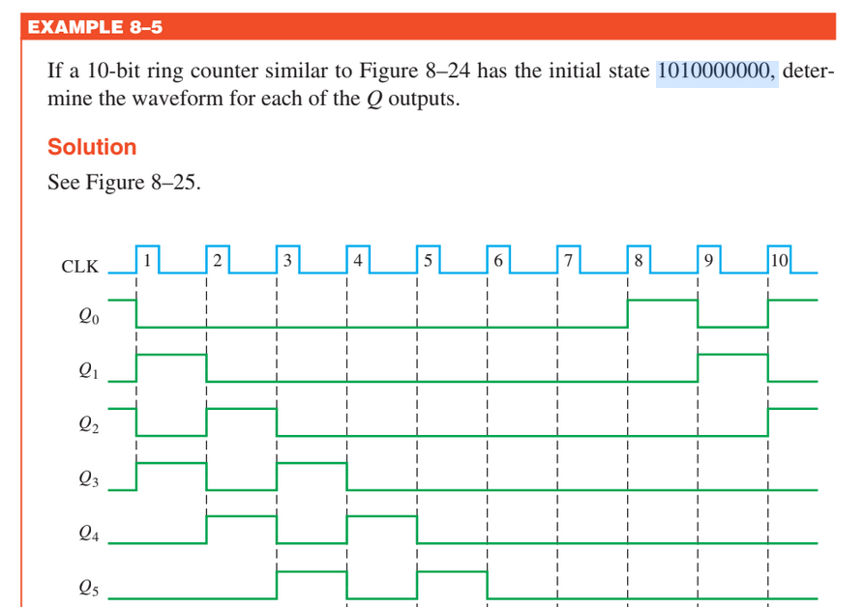
Shift Register Counter ~ The Ring Counter

Slide 25
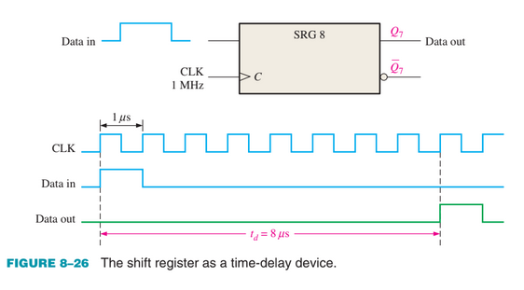
Shift Register Applications
Time Delay
An 8-bit serial in/serial out shift register is used with a clock frequency of 1 MHz to achieve a time delay (td) of 8 micro sec (8 * 1 micro sec).

Slide 26
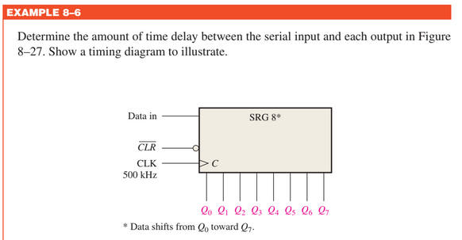
Shift Register Applications
Time Delay

Slide 27
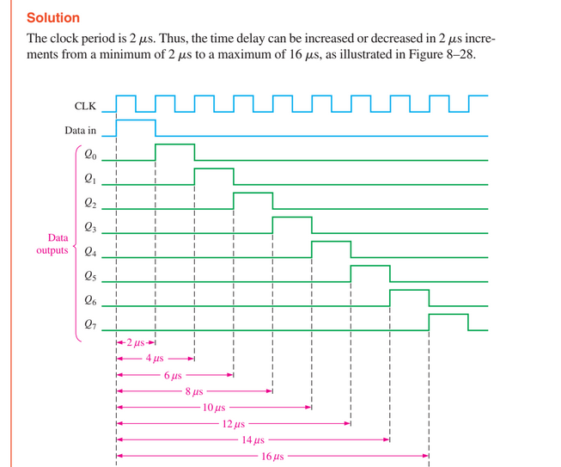
Shift Register Applications
Time Delay

Slide 28
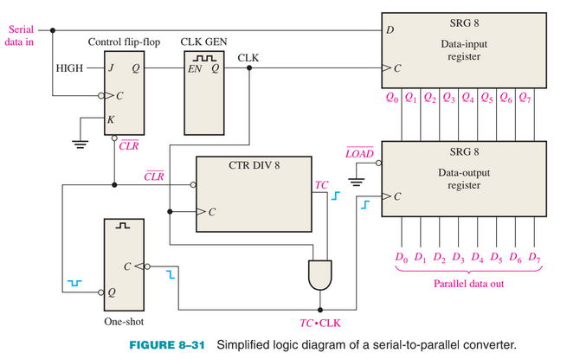
Shift Register Applications
Serial-to-Parallel Data Converter

Slide 29
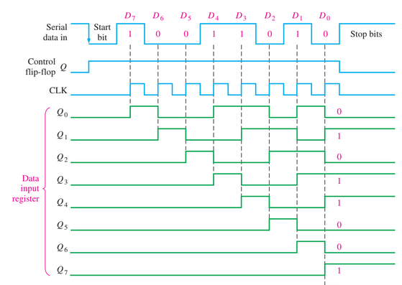
Shift Register Applications
Serial-to-Parallel Data Converter

Slide 30
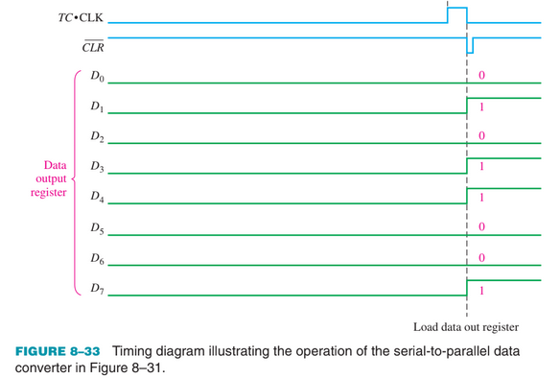
Shift Register Applications
Serial-to-Parallel Data Converter

Slide 31
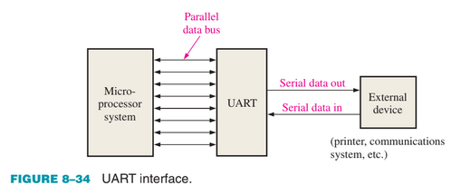
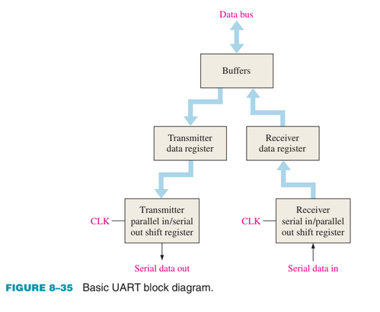
Shift Register Applications
Universal Asynchronous Receiver Transmitter (UART)
The UART receives data in serial format, converts the data to parallel format, and places them on the data bus.
The UART also accepts parallel data from the data bus, converts the data to serial format, and transmits them to an external device.

Slide 32
Practice Questions
https://www.allaboutcircuits.com/worksheets/shift-registers/
https://www.allaboutcircuits.com/worksheets/flip-flop-circuits/

